Slide 1
SECUre data hiding in images using steganography
CAPSTONE PROJECT
Presented By:
Student Name : Gudigopuram Teja
College Name & Department : KKR & KSR Institute of Technology and Sciences, Mechanical Engineering

Slide 2
OUTLINE
Problem Statement
Technology used
Wow factor
End users
Result
Conclusion
Git-hub Link
Future scope

Slide 3
Problem Statement
The goal of steganography is to create methods for securely embedding secret information into a medium in such a way that it remains hidden, imperceptible, and undetectable to unauthorized parties, while also ensuring the message can be accurately and securely extracted when necessary. This involves balancing factors like capacity, imperceptibility, robustness, security, and resistance to detection.

Slide 4
Technology used
Open CV : It is widely used for image processing, computer vision tasks, and machine learning. OpenCV provides a comprehensive suite of tools and functions for manipulating images, videos, and real-time video streaming applications.
String : Python provides a built-in module called string that includes a variety of string manipulation tools. It's important to note that Python strings are immutable, meaning their contents cannot be changed after they are created.
OS Library : The os library in Python provides a way to interact with the operating system in a platform-independent manner. It allows you to perform tasks related to file and directory management, environment variables, processes, and much more. This module abstracts low-level system operations, making it easier for developers to write portable code across different operating systems (Windows, macOS, Linux, etc.).

Slide 5
Wow factors
What makes this project stand out from other project(Unique features)
The "wow factor" of a steganography project that distinguishes it from other projects typically lies in its ability to blend security with creativity, providing an elegant and practical solution to hidden communication. Here are some aspects that could make a steganography project stand out:
Multimedia Steganography
Unnoticed Concealment of Information
Integration of Artificial Intelligence/Machine Learning
Steganography in the Context of Privacy and Security
Ethical and Social Impacts

Slide 6
End users
Who are the end users
The end users of steganography are diverse and span multiple industries and sectors. Since steganography is primarily used for hiding information securely, its end users generally seek confidentiality, privacy, and protection against unauthorized surveillance or data breaches. Here's a breakdown of key end users:
Governments and NGOs
Privacy-Conscious Individuals
Intelligence and Military Agencies
Cryptographers
Digital Forensics Professionals
Businesses (Secure Data Storage and Transmission)

Slide 7
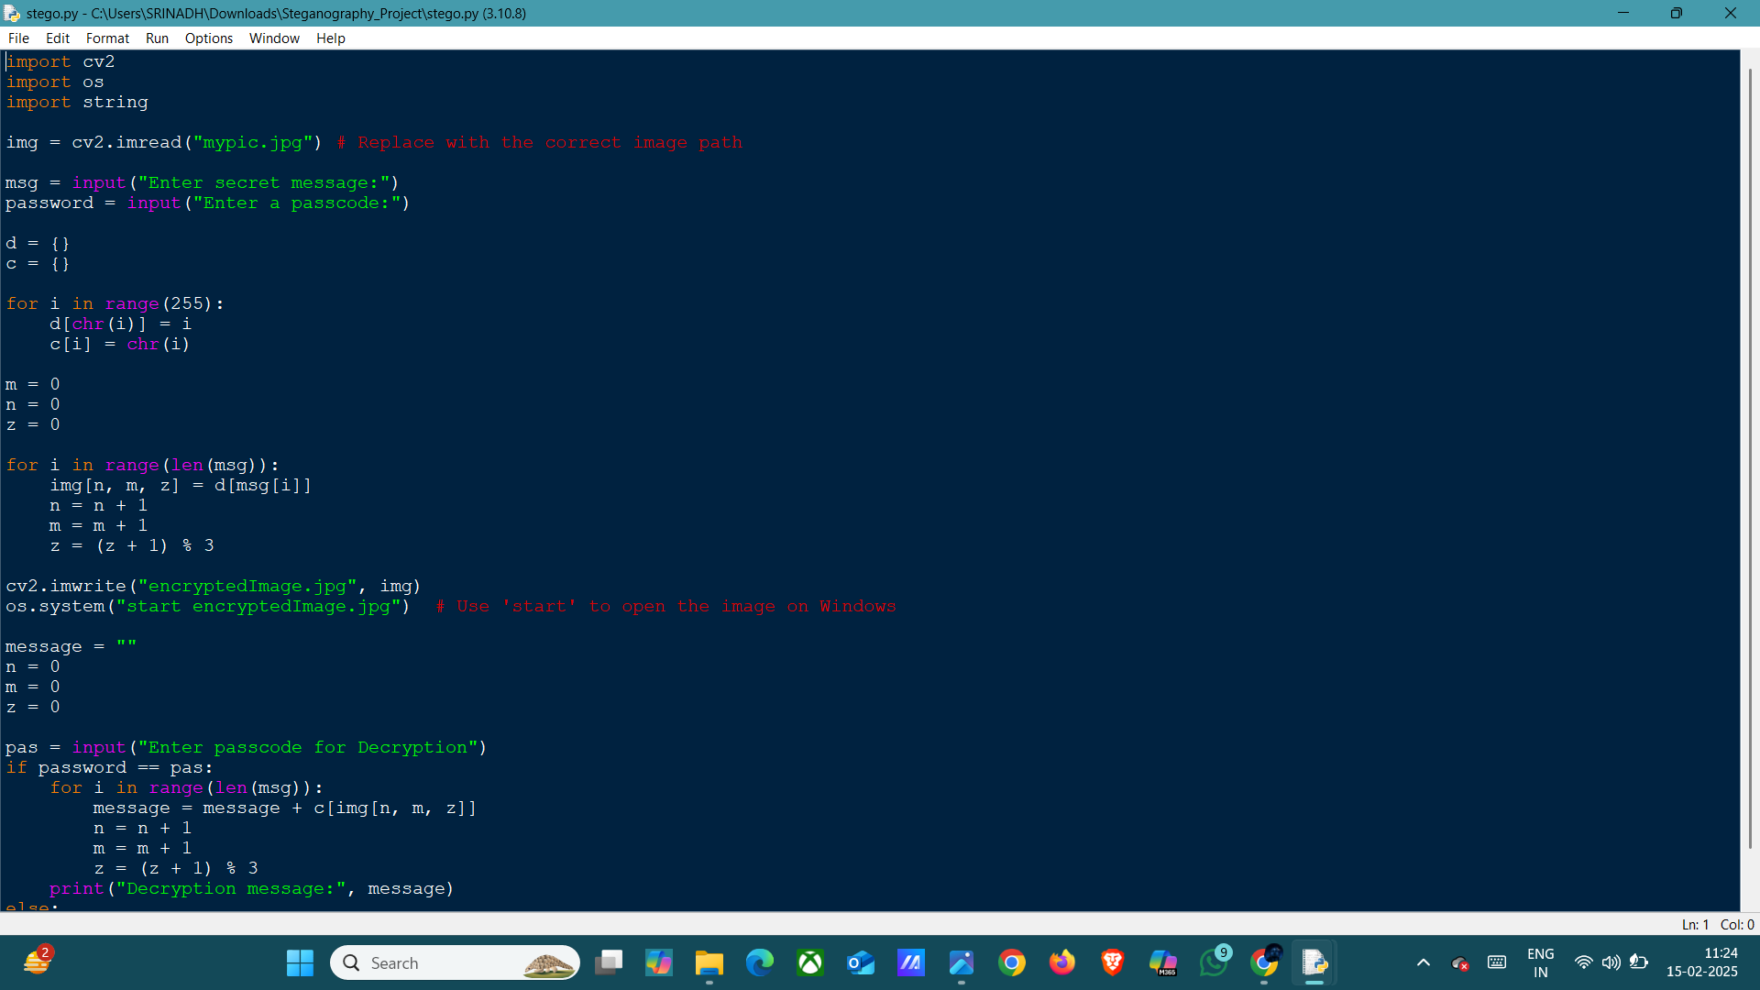
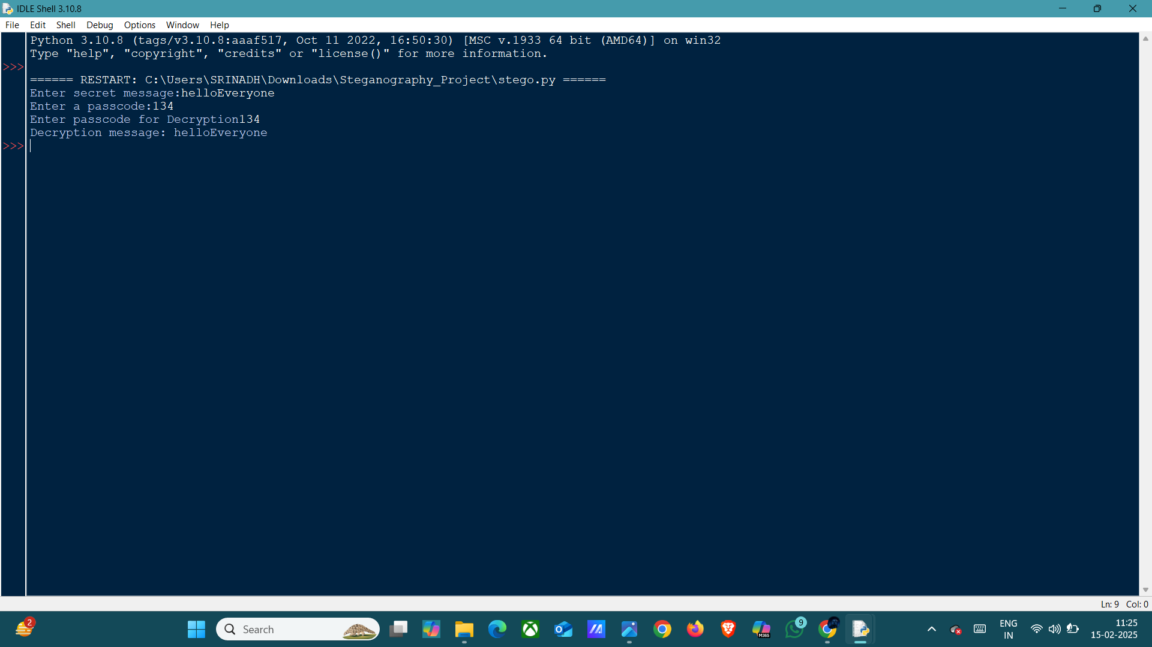
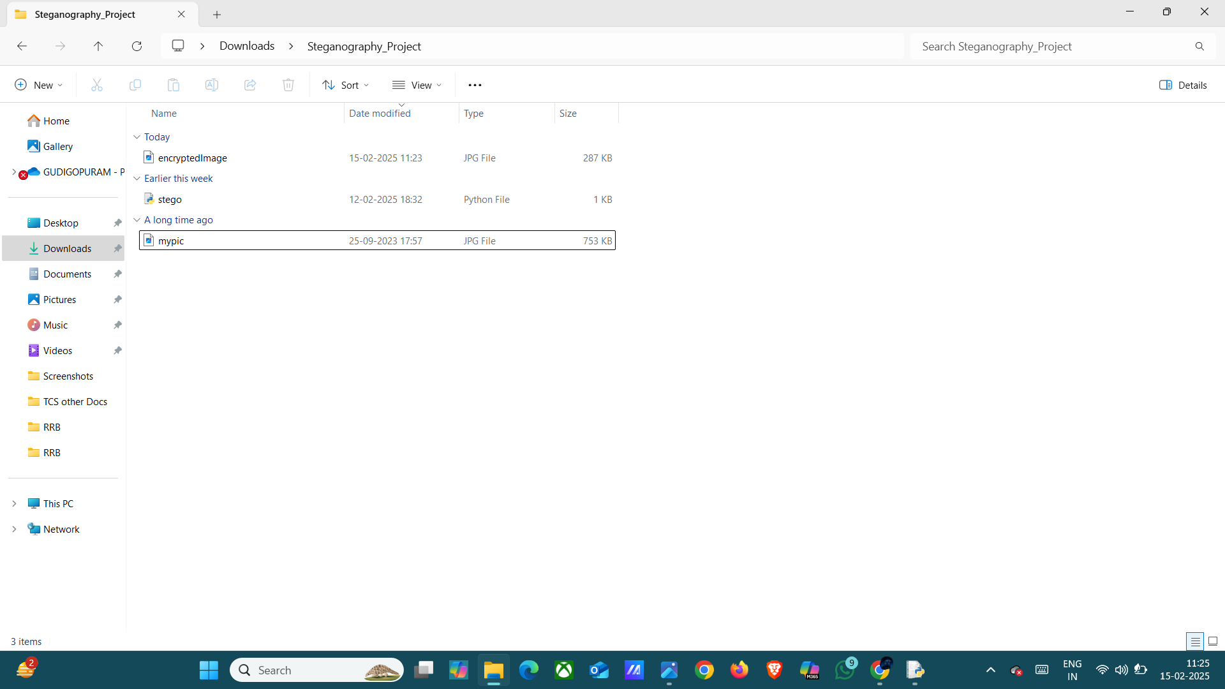
Results

Slide 8
Conclusion
Conclude your project concerning your problem statement
In conclusion, completing your Python steganography project marks a significant accomplishment in applying programming skills to the domain of data security and privacy. By developing a solution to hide information within digital media (such as images, audio, or video), you've not only learned about the technical aspects of steganography but also demonstrated the ability to implement these concepts in real-world applications.

Slide 9
GitHub Link
Make sure that there should be readme file
Link: https://github.com/Teja0806/aicte_steganography_project.git

Slide 10
Future scope(optional)
The future scope of steganography is broad and evolving, driven by advancements in technology, digital security, and the increasing need for privacy in a hyper-connected world. As steganography continues to develop, it is expected to play a key role in a variety of industries, from cybersecurity to privacy protection, digital forensics, and even entertainment. Below are some of the key areas where the future of steganography holds significant potential:

Slide 11
THANK YOU

